Slide 1
NHL Game Prediction Modeling
BrainStation Initial Capstone Presentation
Mark Shumka
October 20, 2023
Notes:
For my project, I will build a model that will attempt to predict the outcome of National Hockey League games

Slide 2
Opportunity
The outcome of National Hockey League games is notoriously difficult to predict relative to other sports
The insights that can come from an accurate prediction model would be of value to multiple stakeholders, including
Team management – owners, general managers, coaches, and others running professional teams
Hockey journalists/websites – people who create content for hardcore and casual hockey fans
Bettors – people who gamble on hockey, and the sportsbook owners who facilitate the process
Potential Impact
Visibility into the underlying drivers of wins would help team management prioritize player acquisition based on relative performance on key metrics. Application to team construction could increase the likelihood of success, which leads to increased revenue (ticket sales, merchandise).
A model that is even slightly more accurate than the betting odds is a huge advantage to people betting on hockey.
As a measure of success, model performance will be evaluated on the ROI it would provide if used to bet on actual games
Notes:
A bit about the opportunity:
- According to most analysis of predictive models, the upper limit of accuracy is in the low 60% range.
- Why is it worth pursuing? It has a huge potential for impact. – teams, bettors, etc.
- For sports like hockey, the true measure of success of a predictive model is the return on investment you would get by using the predictions to bet on games.

Slide 3


How can Data Science address the problem?
Understand patterns and trends from historical data to develop a model to predict the outcome of future games
Basic Stats vs. Advanced Stats
Top-Down vs. Bottom-Up
BASIC STATS
Shots
Goals
Hits
Save Percentage
Power Play Percentage
Faceoffs
ADVANCED STATS
Corsi
Fenwick
xGoals
High Danger Chances
PDO
Flurry Adjusted Expected Goals
Team-based
Player-based
The goal of the analysis is to identify and quantify the stats that have the biggest impact on the outcome of games
Notes:
There are a number of ways to consider building models – what input variables to include?
- There are hundreds of statistics collected from every hockey game. Some of them are what I call basic stats, that is, the ones you could get by reading the box score after the game.
- Some of them are called Advanced Stats, which typically means that they have been derived from algorithms built around basic stats, things like
- I also needed to decide whether I was going to build a top-down (meaning team-based) or (bottom-up) meaning player-based model. Team based looks at aggregated team statistics, while player-based looks at the individual player statistics, then aggregates them at game time (so the outcomes would be different depending on the players that play in that game)
- I’ve decided to focus on a top-down, team-based approach, because I’m not confident that the individual statistics can be added up to predict outcomes.

Slide 4


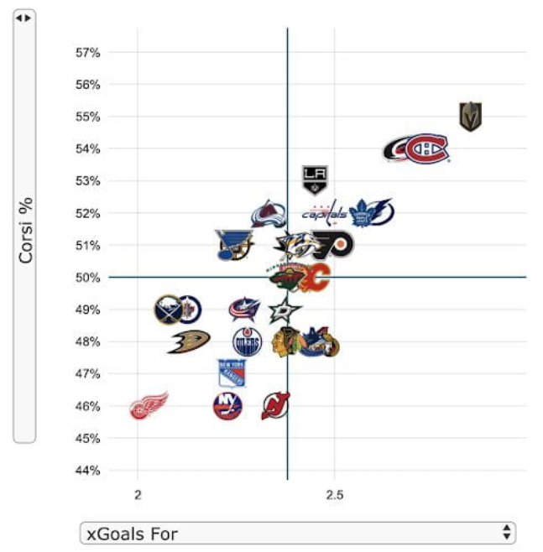
The Dataset
Two Datasets in one
28k columns, 110 rows
Data from every regular season game from 2008-2020
Team-based stats
Dependent Variable = Game outcome (Win/Loss)
Independent Variables = Basic Stats & Advanced Stats (and their components)
55k columns
16 rows
190k columns
111 rows
Notes:
I actually combined two separate datasets into one. The first was game statistics directly from the NHL. The second was a collection of advanced stats from a site called Moneypuck
- 55k rows in one, 190k rows in the other. After merging and cleaning, I had 28k columns and over 100 rows, with data from every regular season game between 2008 and 2020. The dependent variable is the win/loss outcome.

Slide 5
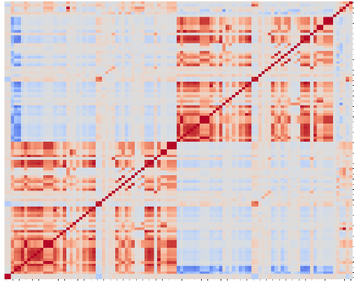
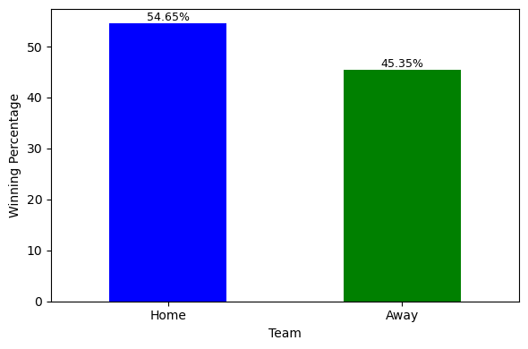
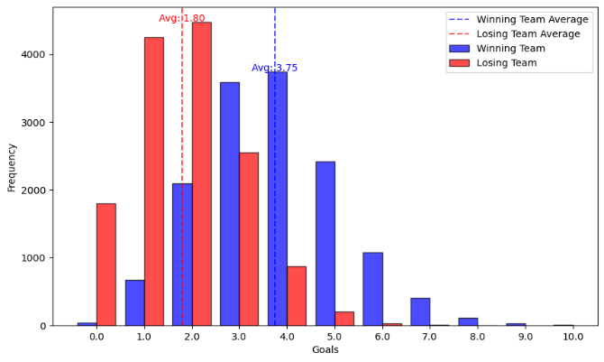
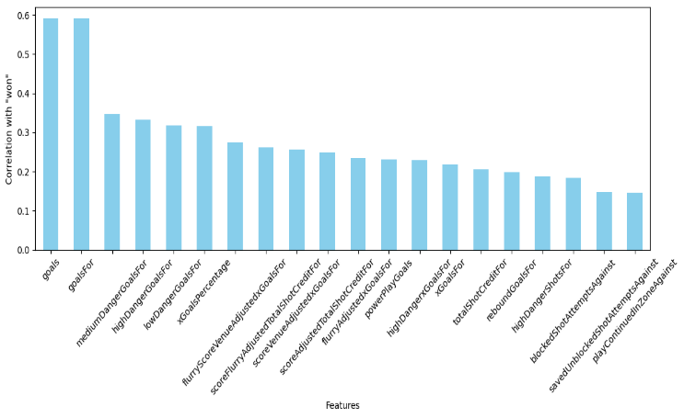
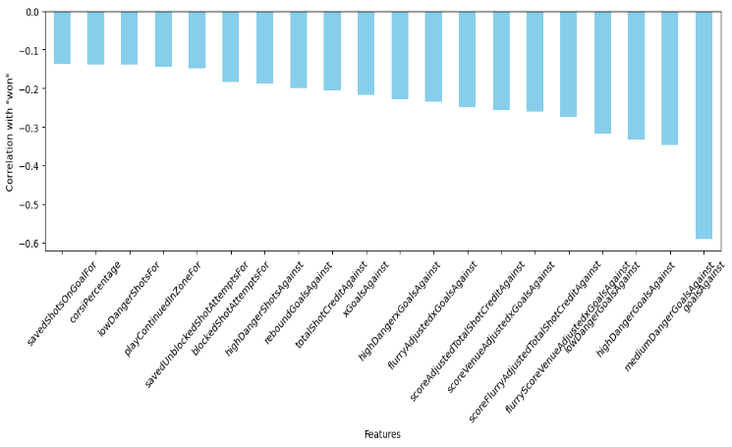
EDA and Initial Findings
Home teams win ~55% of games
Teams score an average of 3.75 goals when they win, 1.8 when they lose
Correlation heatmap of 100+ variables!
Top 20 variables most and least correlated with wins
Notes:
Here are some of my initial findings upon exploring the dataset
- the home team wins 55% of the time. Given that I mentioned that the best models typically have an accuracy of < 65%, there is not a big window of opportunity for success!
- Games average 5.5 goals, which on average are split 2/3 for the winner, and 1/3 for the loser. The margin of victory averages about two goals
- The top 20 variables that are the most and least correlated with wins are typically offensive ones. Goals for is most, goals against is least.
- And I included a correlation heatmap, not because it provides any particular insight, but because I thought it would be cool to see what one with > 100 variables looked like!

Slide 6



Open Questions and Next Steps
Condense the dataset
Expand the dataset
Modelling
Similarity of variables
Multicollinearity
Biggest drivers of wins
Biggest predictors of wins
Missing data
Goalie stats
Time, distance traveled between games
Calculated metrics from raw data (e.g., save%)
Salary cap hit
Time series (i.e., trailing n games)
Logistic regression + machine learning
Phase I – Identify key variables and develop a reactively accurate model
Phase II – Develop forward-looking model with defined inputs that predict outcomes
Notes:
First I will need to pare back some of the variables in the model. There is likely a lot of multicollinearity, as many of the derived advanced stats are made up of some of the same components. I’ll need to isolate the most important ones.
- At the same time, there are some other dimensions I would like to consider that are not in the dataset yet. I mentioned that the dataset only goes to 2020, I would like to update it to the present. I also mentioned that I’m focusing on team-based stats rather than player based stats. The one exception I would like to consider is goaltender stats. The particular goalie that plays in a given game can have a much larger impact on the outcome than any other individual player.
- I’m also interested in the impact of time and distance traveled between games, so may want to include some values for that
Finally, while I believe that my modeling will be successful in identifying the key variables that drive game outcome, I don’t know how helpful that will be in predicting future outcomes. I may consider a time series element, that is, aggregate performance over the past n number of games.
- These feature selection and feature engineering efforts will set me up to begin building models using Logistic Regression and Machine Learning. As I said, my initial focus will be on identifying the variables that drive the outcome, which I will then attempt to use to predict future outcomes.

